Slide 1
AWS Usage Example

Slide 2
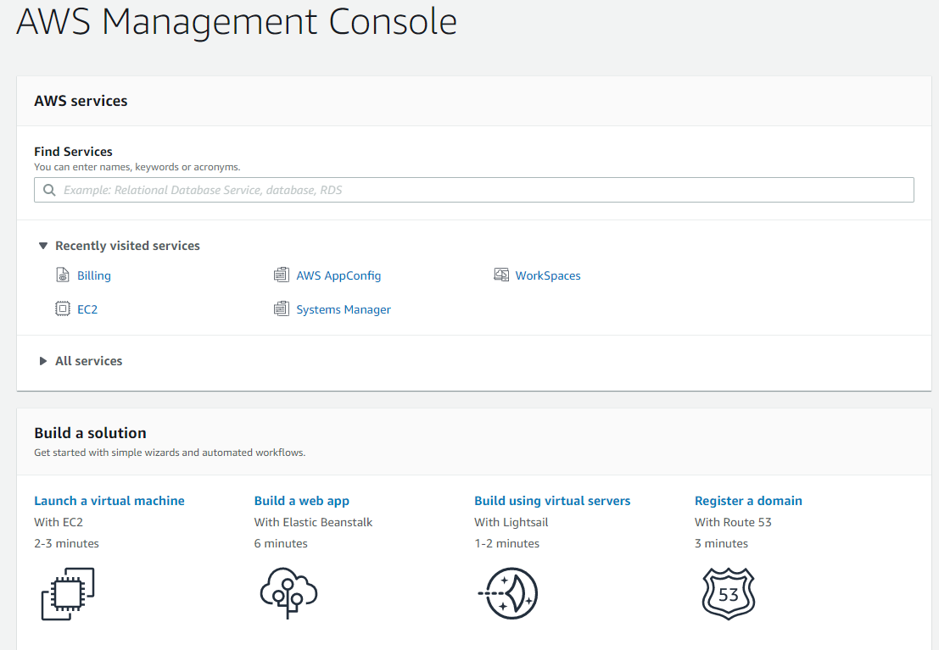
Go to aws.amazon.com and sign in to the console
Launch a virtual machine

Slide 3
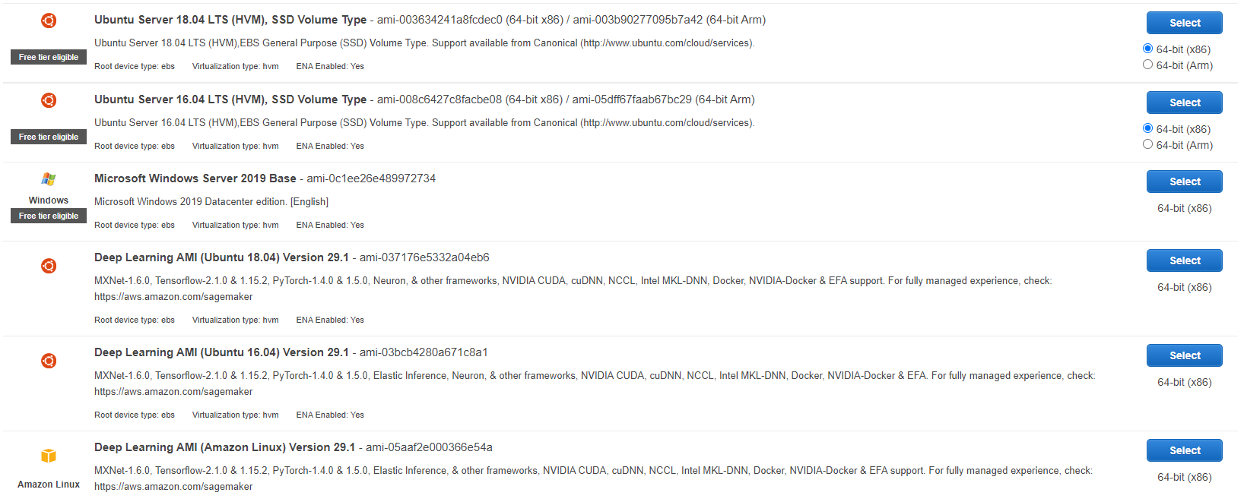
3. Choose an Amazon Machine Image (AMI) depending on your requirements: OS, Libraries, etc.
Examples of AMIs

Slide 4
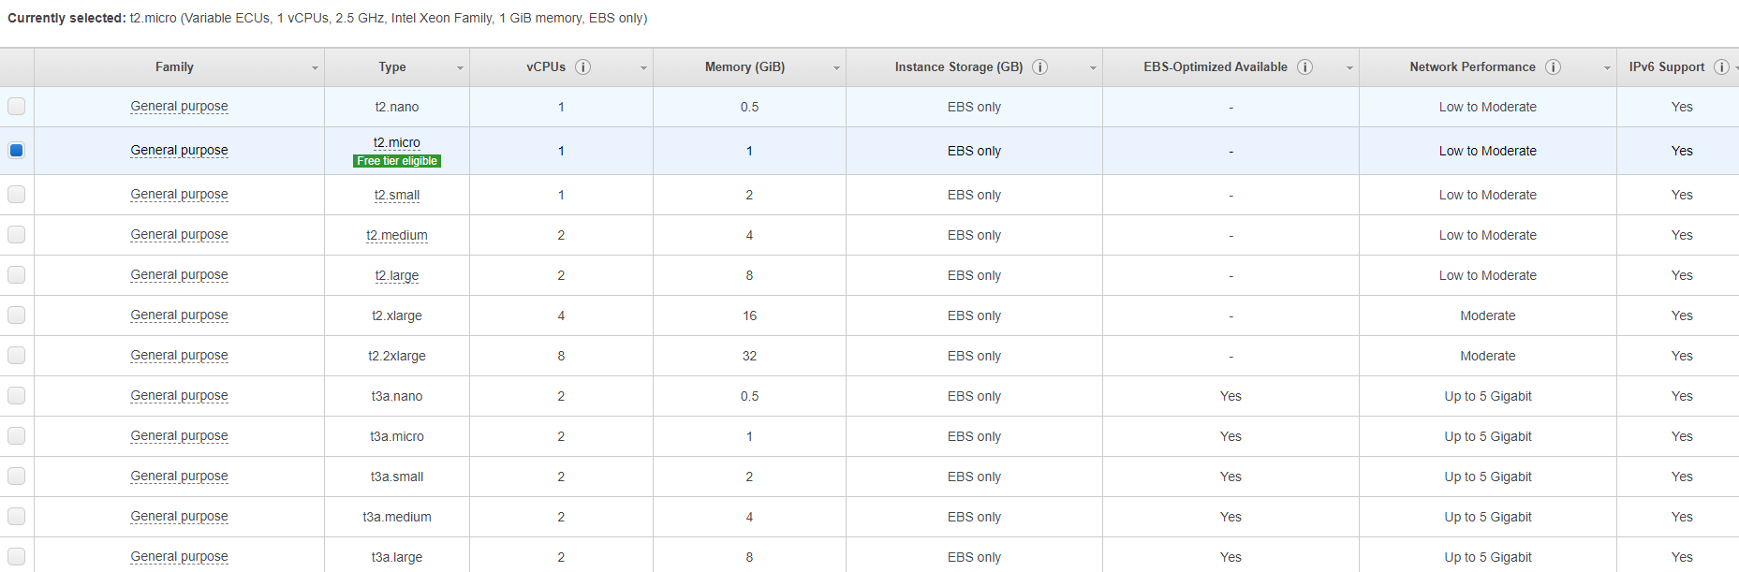
4. Choose an Instance Type
Examples of instance types

Slide 5
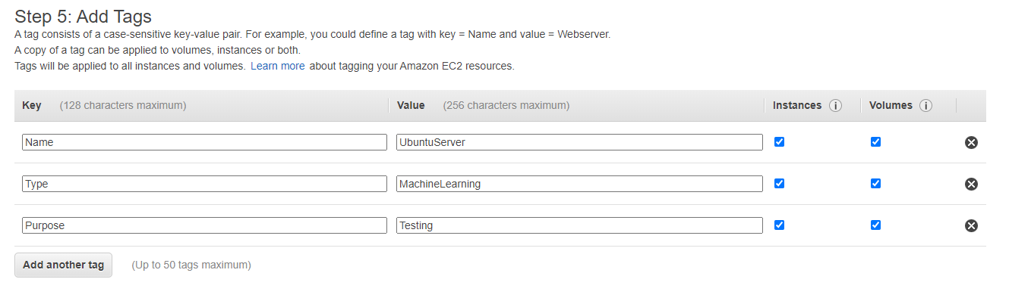
4. For now we can just accept default parameters on Configure Instance Details and Add Storage steps
5. Use tags to provide additional information about our server
6. Review Instance and click “Launch”

Slide 6
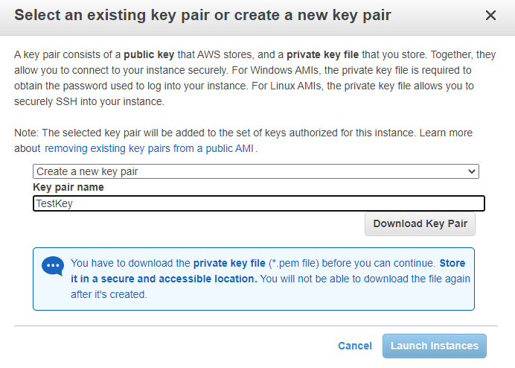
7. Now choose “Create a new key pair”
8. Create a name for a key pair and memorize it
9. Download Key Pair

Slide 7
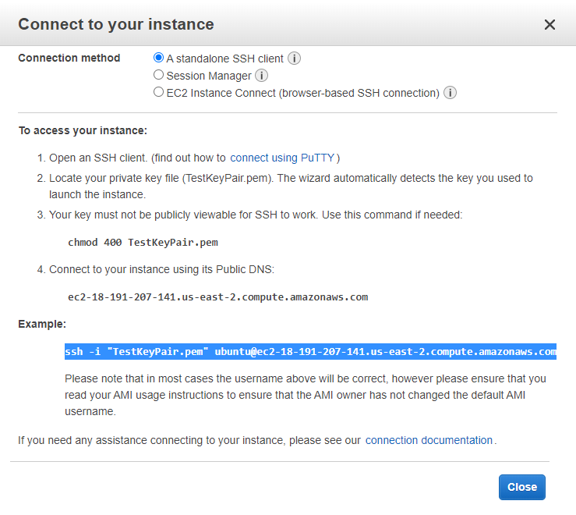
If you use Ubuntu:
10. You can run ssh connection using terminal. Use username “ubuntu” if you chose Ubuntu AMI

Slide 8
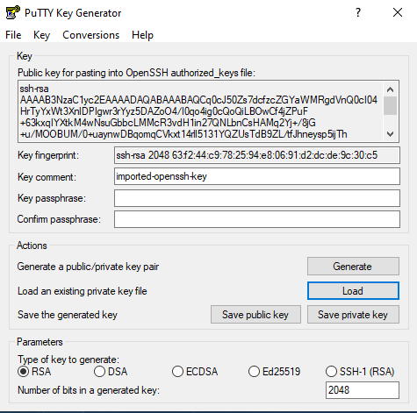
If you use Windows:
10. Download and install PuTTY (https://www.chiark.greenend.org.uk/~sgtatham/putty/latest.html)
11. Open PuTTYgen and load .pem key file
12. Choose “Save private key” option. The saved key should have the same name as Key Pair name from paragraph 9

Slide 9
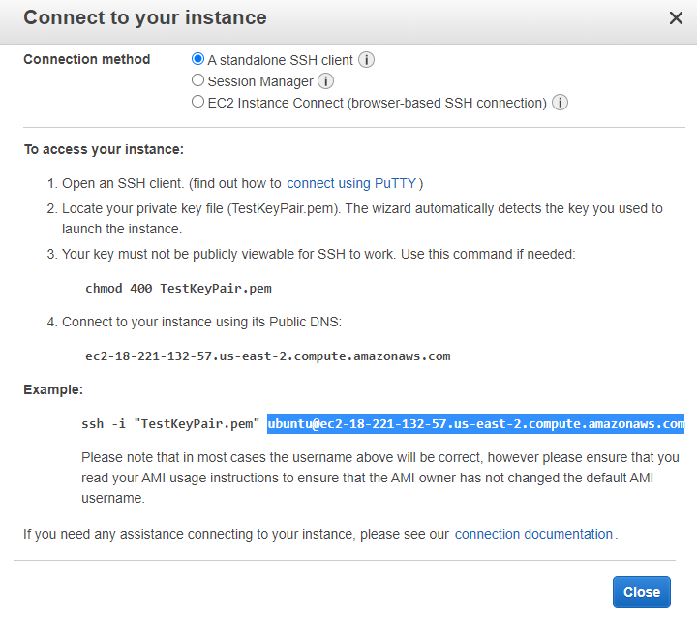
13. Press “View instances”
14. Right click on instance you want to use and choose “Connect”
15. Copy address of the instance

Slide 10
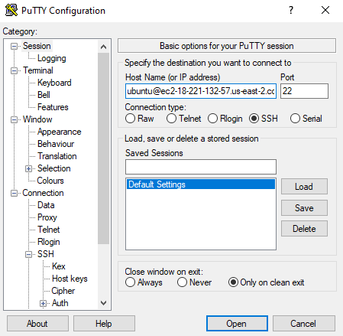
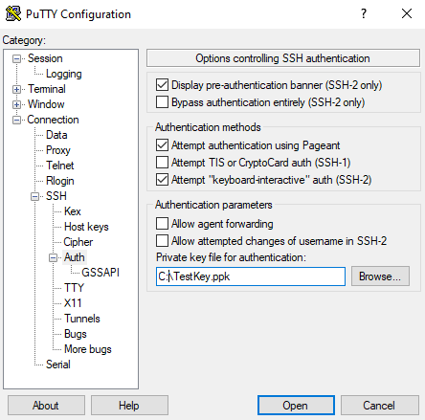
16. Open PuTTY and paste address of the machine
17. Open Connection -> SSH -> Auth in PuTTY and choose .ppk file you saved
18. Click “Open” to connect to the machine. Use username “ubuntu” if you chose Ubuntu AMI
1
2
3
4

